Slide 1

SUTURE MATERIALS AND SUTURING TECHNIQUES
RUNGTA COLLEGE OF DENTAL SCIENCES AND RESEARCH,BHILAI
PRESENTED BY:
Dr Sonika Bodhi
Reader
Dept. of Periodontology

Slide 2
CONTENTS
Introduction
Definition
Goals of suturing
Suture materials
Suture armamentarium- needles, needle holder, scissor
Principles of suturing
Suturing Techniques
Knots
Suture Removal and complications

Slide 3
INTRODUCTION
The act of sewing or bringing the tissue together and holding them in apposition until healing has taken place.
Though various methods and materials have been used (sutures, stents, paste dressings, tissue tacks and adhesives) for precise flap placement, Suturing has remained the most popular gold standard method to position and secure surgical flaps in order to promote optimal healing (first / primary intention).

Slide 4
DEFINITIONS
Any Strand of Material utilised to ligate blood vessels or approximate Tissues .
(Silverstein L.H 1999)
Strand of material that is used to approximate tissues or to ligate blood vessels during the wound-healing period.
(Ratner et al. 2004)

Slide 5
Suture is a stitch/series of Stiches made to secure apposition of the edges of a surgical/traumatic wound.
(Wilkins)
A stitch or row of stitches holding together the edges of a wound or surgical incision.
(Oxford Dictionary)

Slide 6
HISTORY
The earliest use of suture has been reported in ancient Egypt(From past 3000 BC).
Between 500-100 BC. , oldest physical evidence of surgical suture has been reported as several mummies in Egypt were found who had been sutured.
In 400 BC HIPPOCRITES first used the term ‘suture’ which means to ‘sew’.
East African tribes ligated blood vessels with tendons and closed wounds with acacia throns.

Slide 7
In 500 BC. , the Indian physician Sushruta gave the first detailed description of a wound suture and suture materials.
Galen, (the physician to Roman gladiators) in the second century A.D. used silk for hemostasis.
Andreas Vesalius first advocated the suture of all fresh wounds as well as severed tendon and nerves.
Joseph Lister (1867)
Discovered that bacteria present in suture strands cause wound infection. He disinfected silk sutures with carbolic acid.

Slide 8
In 1869, Lister changed to ‘catgut’ suture, which was being widely used in Germany due to its absorbability. The trials showed great reduction in infection rates.
During 10th century CATGUT was manufactured by harvesting it from sheep intestine.
Till 1930 , catgut was the staple absorbable suture material & silk and cotton were non-absorbable suture materials.
Advancements in suture materials took place after the introduction of nylon in 1938 and polyester around the same time.

Slide 9
GOALS OF SUTURING
Provide an adequate tension of wound closure without dead space but loose enough to obviate tissue ischemia and necrosis.
Maintain hemostasis.
Permit primary intention healing.
Provide support for tissue margins until they have healed and the support is no longer needed.
Reduce postoperative pain.
Prevent bone exposure resulting in delayed healing and unnecessary resorption.

Slide 10
REQUISITES OF SUTURE MATERIALS
Tensile strength
Tissue biocompatibility
Low capillarity
Good handling & knotting properties
Sterilization without deterioration of properties
Non allergic, non electrolytic and non carcinogenic
Its use should be possible in any operation.
Low cost

Slide 11
Principles of Suture Selection
The selection of a suture material by a surgeon must be based on a sound knowledge of the:
a. Healing characteristics of the tissues, which are to be approximated.
b. The physical and biological properties of the suture materials.
c. The condition of the wound to be closed.
d. Probable post-operative course of the patient.

Slide 12
Suture’s Physical Characteristics
The Physical Configuration
The Tensile Strength
The Knot Strength
The Elasticity
The Plasticity

Slide 13
CLASSIFICATION
Multiple suture materials are available, which are classify based on their properties like filament type (i.e. monofilament & polyfilament), diameter & restorability.

Slide 14
SUTURE MATERIALS
SOURSE STRUCTURE FATE COATING
-Natural -monofilament -absorbable - coated
-synthetic - multifilament -Non – absorbable -Uncoated
-metallic

Slide 15
NATURAL
Absorbable
Catgut
Chromic catgut
Collagen
Fascia lata
kangaroo tendon
Beef tendon
Cargile membrane
Non-Absorbable
Silk
Silk worm gut
Linen
Cotton
Ramie
Horse hair

Slide 16
SYNTHETIC
Absorbable
Polyglycolic Acid
Polyglactic Acid
Polyglactin 910(Vicryl)
Polydioxanone(PDS)
Polyglecaprone 25
Non Absorbable
Nylon/ polyamide
PolyPropylene
Polyesters
Polyethelene
Polybutester
Polyvinylidene fluoride / PVDF Sutures

Slide 17
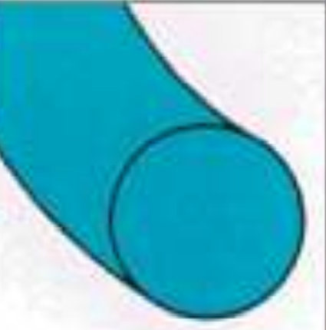
MONOFILAMENT
Absorbable
Surgical Gut- Plain, Chromic
Polydiaxanone
Polyglactin 910
Non Absorbable
Polypropylene
Polyester
Nylon/polyamide
Polyvinylidene fluoride / PVDF Sutures

Slide 18
Advantages
• Smooth surface
• Less tissue trauma
• No bacterial harbours
• No capillarity
Disadvantages
• Handling and knotting
• Stretch
• Any nick or crimp in the material leads to breakage.

Slide 19
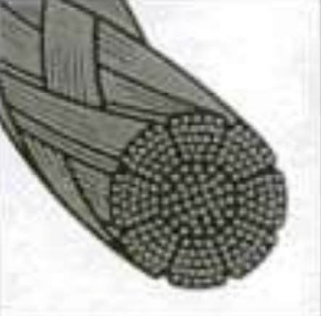
MULTIFILAMENT
Absorbable
Polyglactin 910
Polyglycolic Acid
Non Absorbable
Silk
Cotton
Linen

Slide 20
Advantages
• Strength
• Soft and pliable
• Good handling
• Good knotting
Disadvantages
• Bacterial harbours
• Capillary action
• Tissue trauma

Slide 21
Metallic suture
Tantalum
Gold
Silver
Aluminium

Slide 22
Non absorbable sutures are categorized by the United States Pharmacopeia (USP) as
Class I
-Silk or synthetic fibers of monofilaments with twisted or braided construction
Class II
-Cotton or linen fibers, coated natural or synthetic fibers in which the coating does not contribute to T.S
Class III
-Metal wire of monofilament or multifilament construction.

Slide 23
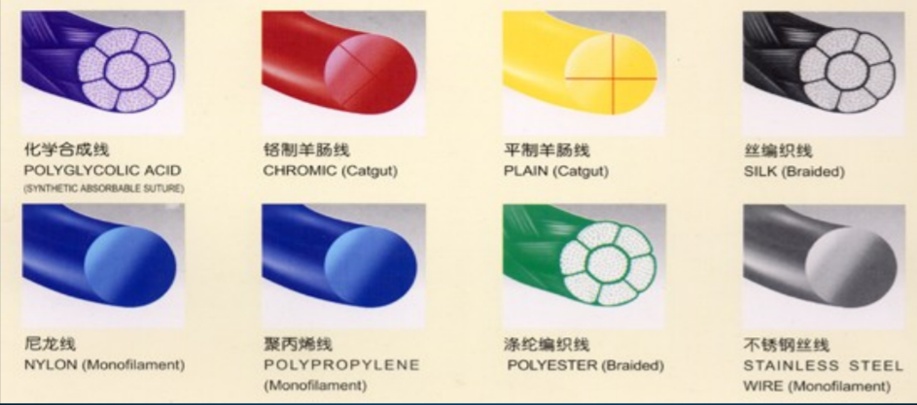
Suture materials used in regular practice

Slide 24
ABSORPTION OF SUTURE MATERIALS
Degraded either by enzymatic process as in gut sutures, or by hydrolysis, as in many of the synthetic materials like glycolic acid, ployglactin910 or polydioxanone.
Non absorbable sutures are walled off or encapsulated.

Slide 25
In infected tissues or in a patient who is febrile or protein deficient, suture breakdown may be accelerated.
If the loss of TS outpaces the healing phase, failure of the wound results.
Absorbable sutures must be placed well into the dermis.

Slide 26
BIOLOGIC RESPONSE OF BODY TO SUTURE MATERIALS
The initial body response to sutures is almost identical in the first 4-7 days, regardless of the suture material.
The early response is a generalized acute aseptic inflammation, involving primarily polymorphonuclear leukocytes.
After few days mononuclear cells, fibroblasts & histiocytes become evident.
Capillary formation occurs at the end of this initial phase.

Slide 27
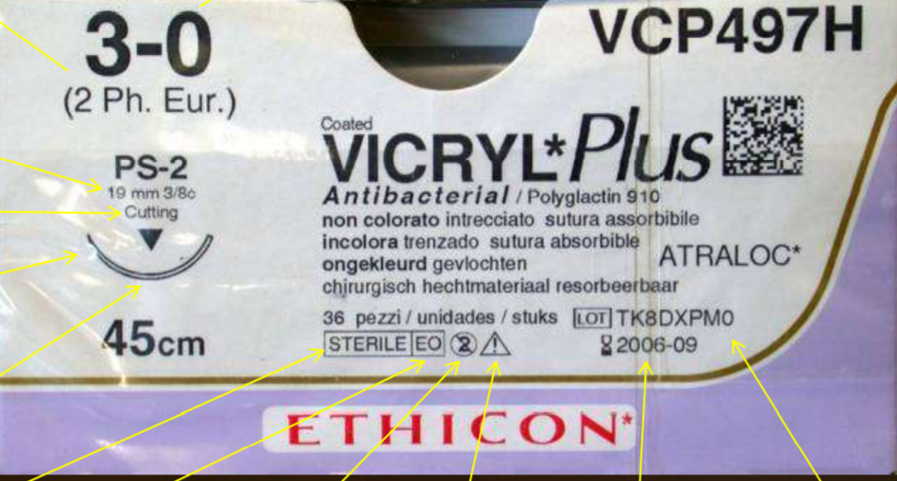
IMPERIAL GUAGE
METRIC GUAGE
NEEDLE SIZE & CURVATURE
NEEDLE TYPE
NEEDLE TIP
NEEDLE PROFILE
DO NOT REUSE
BATCH NO
EXPIRY DATE
ETHELENE OXIDE
STERILIZED
SEE INSTRUCTIONS FOR USE

Slide 28
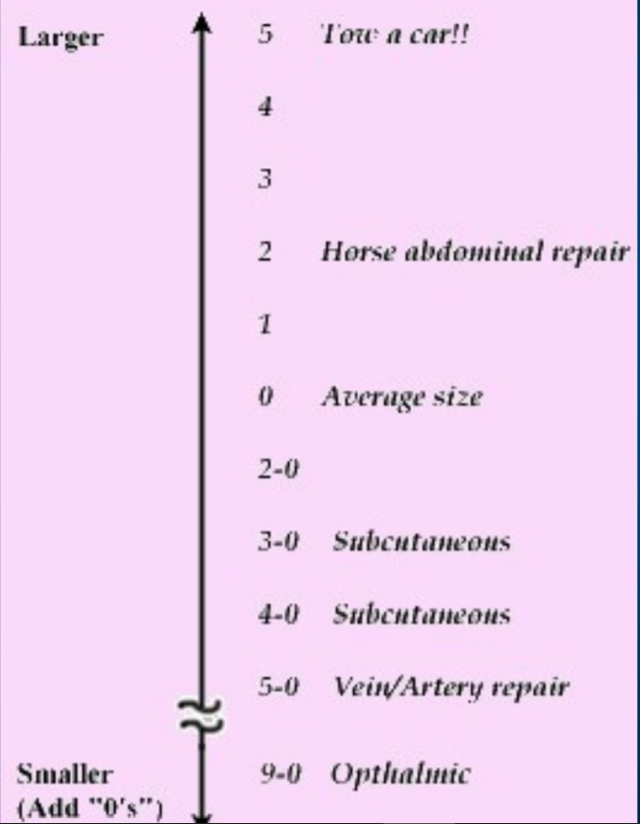
SUTURE SIZES
Largest size 1 to extremely fine 11-0.
Increasing number of zeroes correlates with decreasing suture diameter and strength.
Thicker sutures are used for approximation of deeper layers, wounds in tension prone areas and for ligation of blood vessels.
Thin sutures are used for closing delicate tissues like conjunctiva and skin incisions of the face. Size is chosen to correlate with the tensile strength of the tissue being sutured.

Slide 29
UNITED STATES PHARMACOPEIA
Sized according to diameter with “0” as reference size Numbers alone indicate progressively larger sutures (“1”,“2”, etc) .
Numbers followed by a “0” indicate progressively smaller sutures (“2-0”, “4-0”, etc) .
Smaller<------------------------------------->Larger .....”3-0”...”2-0”...”1-0”...”0”...”1”...”2”...”3”.....

Slide 30
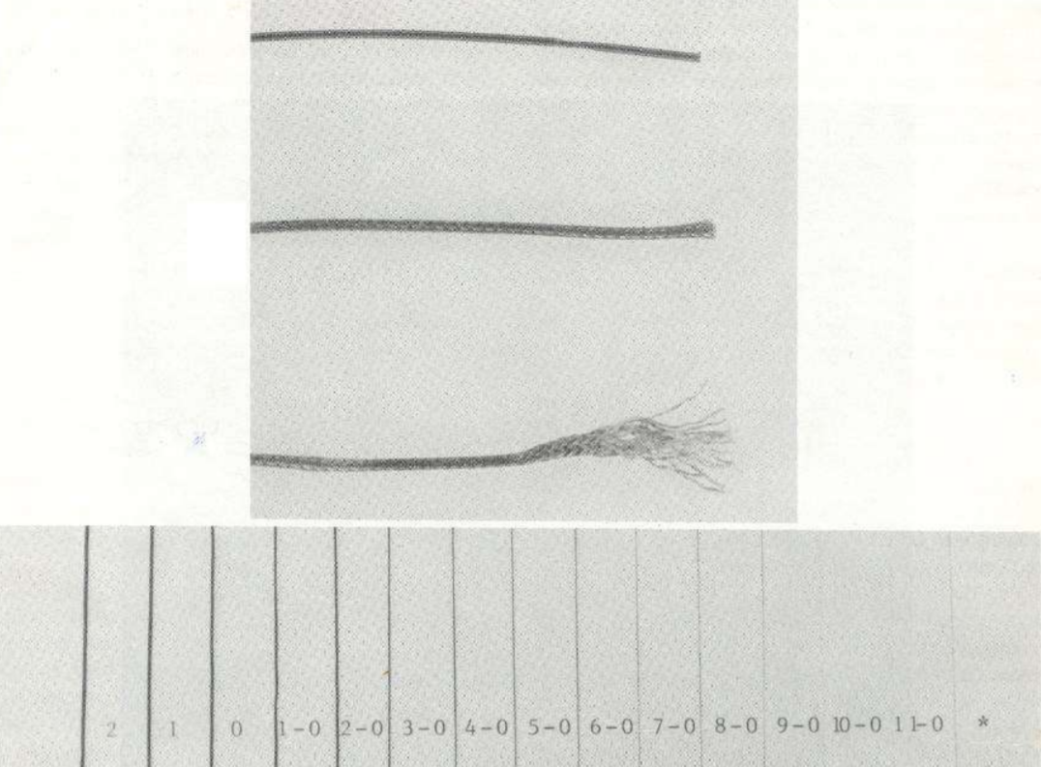
3-0 or 4-0 OMFS, muscle, deep skin
5-0 or 6-0 facial skin closure
9-0 or 10-0 microsurgery

Slide 31
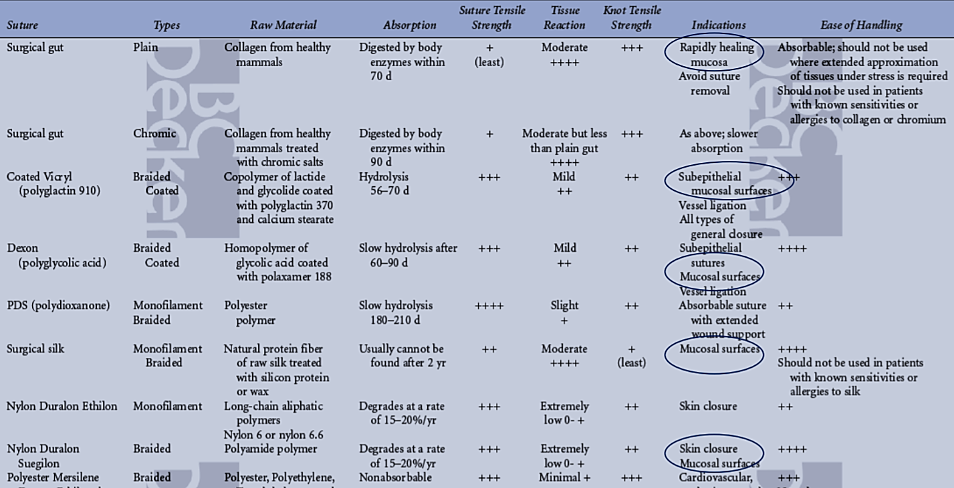

Slide 32
STERILIZATION OF SUTURES
May affect suture properties to some extent
Gamma Radiation
Ethylene oxide; poisonous gas is less attractive
Autoclave
Sutures are usually stored in sterile pack by the manufacturers , their integrity must be checked before use.

Slide 33
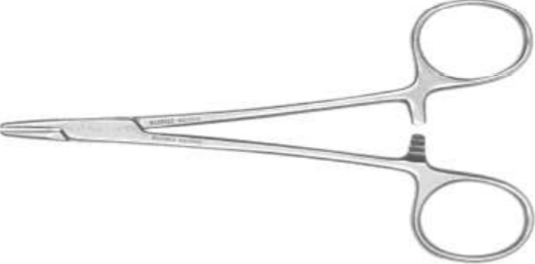
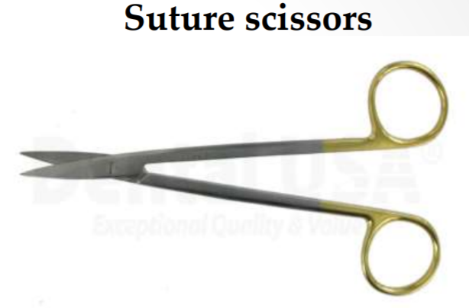
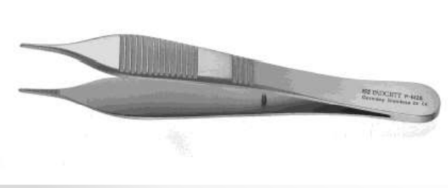
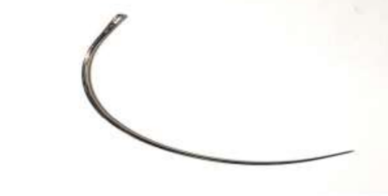
ARMAMENTARIUM FOR SUTURING
Needle holder
Adson forceps
A suture needle

Slide 34
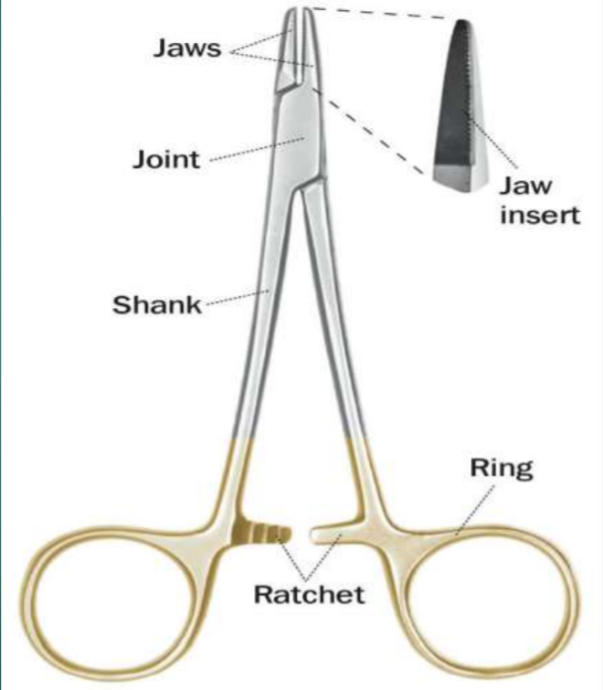
Needle holder
The needle holder is used to handle the suture needle and thread while suturing the surgical wound.
If used properly it enables the surgeon to perform procedures correctly and with great precision.
Parts:
Working tip/jaws
Hinge joint
Shank/body
Catch mechanism/ratchet
Grip area

Slide 35
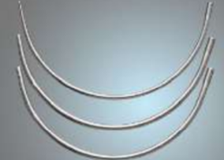
A suture needle
Surgical needles are designed to lead suture material through tissue with minimal injury.
Needles can be - straight (GIT) or curved
- swaged or eyed
Made up of either SS or carbon steel.
Needle is selected according to:
-type of tissue to be sutured
-tissue’s accessibility
-diameter of suture material.

Slide 36
Ideal Properties Of Needles
High quality stainless steel
Smallest diameter possible
Capable of implanting sutures with minimal trauma to tissues.
Stable in the needle holder
Should be sharp.
Sterile and corrosion resistant.

Slide 37
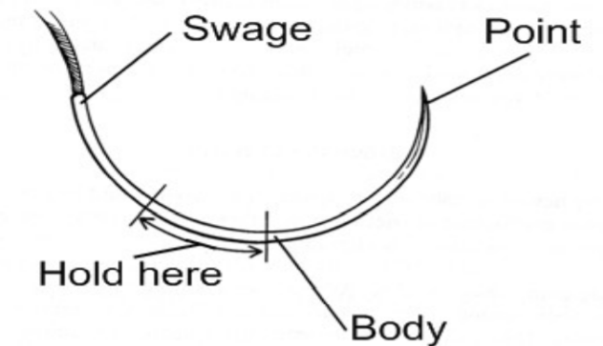
1-The eye- to which suture material is attached. Instrumentation here will break or weaken the suture. permits the suture and needle to act as a single unit to decrease trauma
2-The body is the strongest & widest point of the needle and is also referred to as the grasping area
3-The point- the sharpest portion and is used to penetrate the tissue. Shape varies.

Slide 38
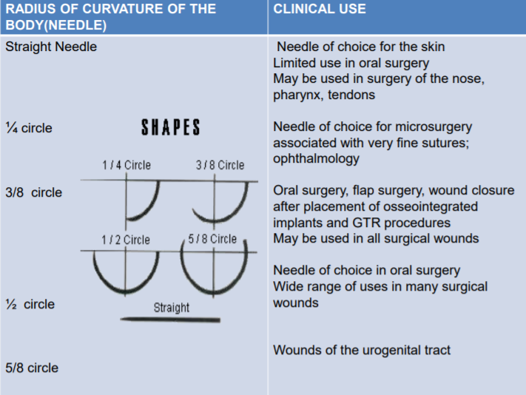

Slide 39
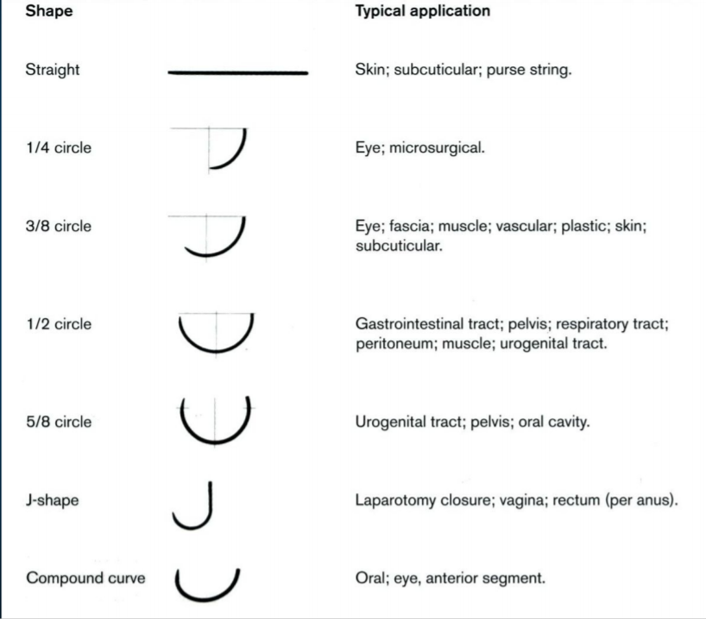

Slide 40
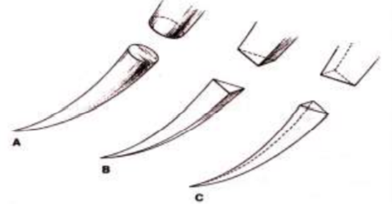
According to its tip :
1.Triangular
2.Round
3.Blunt

Slide 41
PRINCIPLES OF SUTURING
1.Needle grasped at 1/4th to half the distance from eye.
2.Needle should enter perpendicular to tissue surface
3.Needle passed along its curve
4.The bite should be equal on both sides of the wound margin and the point of the entry of the needle should be closer to the wound edge than its point of exit on the deep surface

Slide 42
Suture knots
Surgical knot tying is an important component of the art of suturing. There are primarily four types of knots used,
Square knot: Two single ties in opposite direction
Granny's knot: Two or three ties in the same direction.
Surgeon's knot 2-1: Two ties in one direction and third in theopposite.
Surgeon's knot 2-2: Two tie in one direction and two inopposite direction

Slide 43
Summery
Suture material and technique of closure does not influence wound outcome in patients of peritonitis except for a significantly lower incidence of sinus formation when non-absorbable sutures are used

Slide 44
References
Newman MG, Takei HH, Klokkevold PR, Carranza FA. Carranza’s clinical periodontology, 10th ed. Saunders Elsevier; 2007.
Lindhe J, Lang NP and Karring T. Clinical Periodontology and Implant Dentistry. 6th ed. Oxford (UK): Blackwell Publishing Ltd.; 2015.
Newman MG, Takei HH, Klokkevold PR, Carranza FA. Carranza’s clinical periodontology, 13th ed. Saunders Elsevier; 2018.

